Slide 1
Splunk for AIOps
June 2020

Slide 2
The Only Platform for Monitoring, Observability & AIOps
New Version in color palette currently being used
For Every App, Every Location, Every Team
Retain & Optimize
Lift & Shift
Re-Factor
Re-Architect
ITOPS
DEVOPS
IT Automation & Workflow Orchestration
Splunk Phantom
Intelligent On-Call & Incident Response
VictorOps
AIOps (Service Insights, Event Analytics & Automated Remediation)
Splunk IT Service Intelligence
Monitoring Hybrid Infrastructure
Splunk App for Infrastructure
Observability for Cloud, Microservices & DevOps
SignalFx
Physical & Virtual Infrastructure Monitoring
Cloud Monitoring
Microservices APM
Splunk Enterprise | Splunk Cloud

Slide 3
The Only Platform for Monitoring, Observability & AIOps
New Version in color palette currently being used
For Every App, Every Location, Every Team
Retain & Optimize
Lift & Shift
Re-Factor
Re-Architect
ITOPS
DEVOPS
IT Automation & Workflow Orchestration
Splunk Phantom
Intelligent On-Call & Incident Response
VictorOps
AIOps (Service Insights, Event Analytics & Automated Remediation)
Splunk IT Service Intelligence
Monitoring Hybrid Infrastructure
Splunk App for Infrastructure
Observability for Cloud, Microservices & DevOps
SignalFx
Physical & Virtual Infrastructure Monitoring
Cloud Monitoring
Microservices APM
Splunk Enterprise | Splunk Cloud

Slide 4

Breadth of Machine Learning Capabilities
Make IT Effective, Proactive and Predictive
Adaptive Thresholding
Thresholds adapt in real time
Trend and alert on anomalous behavior
Prevent service degradation
Event Clustering
Detect and highlight the events that matter
Prioritize events that need action taken
Anomaly Detection
Alerts triggered automatically by anomalous activity
Incident responders can see across all silos to find a quicker MTTR
Prediction
Predict outages and anomalies before they occur
Act on these predictions so your services are not affected
Service Models
Entities - KPIs – Episode
Business Context

Slide 5
Breadth of Machine Learning Capabilities
Make IT Effective, Proactive and Predictive
Adaptive Thresholding
Thresholds adapt in real time
Trend and alert on anomalous behavior
Prevent service degradation
Event Clustering
Detect and highlight the events that matter
Prioritize events that need action taken
Anomaly Detection
Alerts triggered automatically by anomalous activity
Incident responders can see across all silos to find a quicker MTTR
Prediction
Predict outages and anomalies before they occur
Act on these predictions so your services are not affected
Service Models
Entities - KPIs – Episode
Business Context

Slide 6
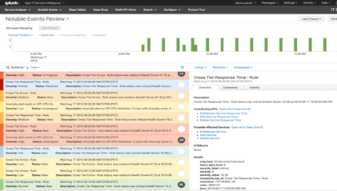
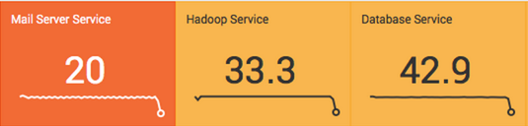
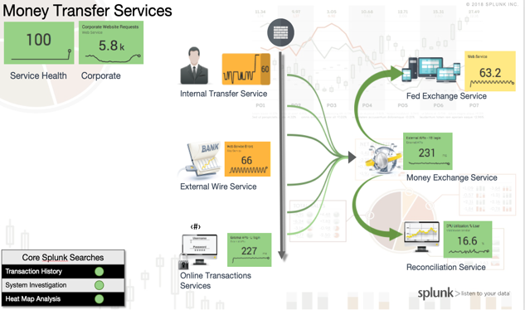
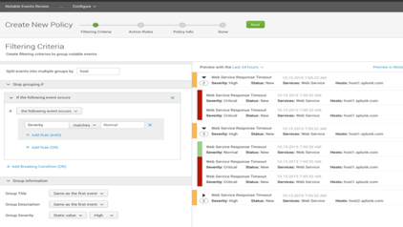
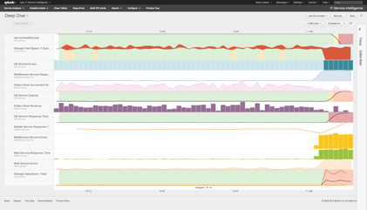
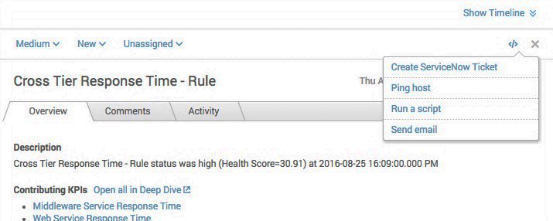
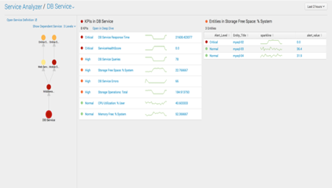
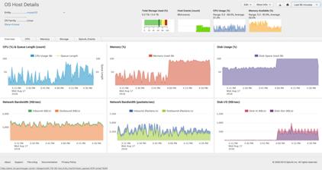
Splunk IT Service Intelligence (ITSI) Capabilities
EVENT ANALYTICS
SERVICE INSIGHTS
Sophisticated analytics and alert workflow to automate managing events
Service health scores calculated from KPIs
Contextual glass tables present business friendly performance perspective
Machine learning to reduce noise and create alerts on root causes of issues
Organized view of disparate KPIs and trends for fast triage and analysis
Integrated workflow for alert response and resolution
One solution, multiple personas. Operators and engineers collaborate for triage and investigation
Deep insights into technology domains to speed investigation

